Slide 1
Tradition, Innovation and the 21st Century University
Dr Kevin Dunseath
Libya Higher Education Forum
5-6 June 2014
Education | Training | Strategy

Slide 2
Agenda
Founding a University
Key Issues and Challenges
The Innovation Imperative
Innovation Across the University
Education | Training | Strategy

Slide 3
The University and the Innovation Imperative
In 10-15 years, 25% of universities will merge or disappear
“…Online education is a disruptive innovation …. Many bricks-and-mortar colleges are making the same mistake… They are not saving students time and money, the essential steps to disruption.…a host of struggling colleges and universities — the bottom 25 percent of every tier, we predict — will disappear or merge in the next 10 to 15 years.
Already traditional universities are showing the strains of a broken business model, reflecting demand and pricing pressures previously unheard-of in higher education.”
Christensen and Horn: NY Times, 1 Nov 2013
Education | Training | Strategy

Slide 4
Local, Regional, Global
“As globalisation occurs, the local becomes more, not less, important. The further development of the university and the city should now become central to any traditional university. This is a role the classic university can play. An online university or a MOOC cannot.”
A classic university must build relationships with cities by creating the virtuous circle of:
Good university
Close links with business and public authorities
Collaborative research and development
Spin-offs, spin-outs and start-ups
The attraction of talented students and faculty
The development of ‘cool’ places to live
Barber, Donnelly and Rizvi (2013): An Avalanche is Coming, Institute for Public Policy Research
Education | Training | Strategy

Slide 5
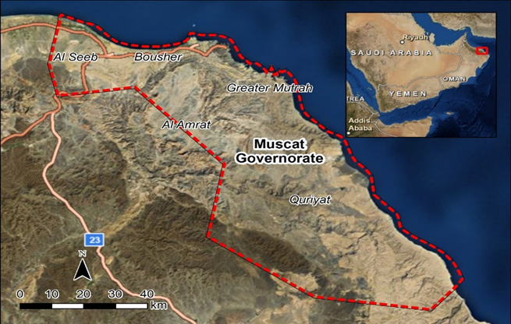
The Muscat University Project
Managing project for Oxford University’s technology transfer company, Isis Innovation
The lead consultant to establish a new private university in Muscat, Oman
Backed by a large group of Oman’s leading business families and the Government of Oman
Muscat University will be innovative and entrepreneurial
Its programmes will combine academic rigour with direct relevance to the world of work
Education | Training | Strategy

Slide 6
Key Issues and Challenges
To succeed, Muscat University must:
Establish a compelling UVP around innovation and entrepreneurship – not just more of the same
Recruit and retain high quality faculty, staff and students
Provide excellent facilities and infrastructure
Establish meaningful international affiliation agreements
Generate significant third stream revenue
Embrace technological innovation
Start small and lean
Education | Training | Strategy

Slide 7
Managing the Pressures
Cost
Quality
Access
Education | Training | Strategy

Slide 8
The Entrepreneurial University
Ten Attributes of the Entrepreneurial University:
Is not dependent on the State
Recognises itself as a business
Seeks opportunities for innovation
Takes risks and tolerates failures
Is customer-driven, not product-driven
Empowers, not controls, faculty and staff
Is led by an entrepreneurial senior team
Encourages interdisciplinarity
Rewards intrapreneurs
Requires patient money
Education | Training | Strategy

Slide 9
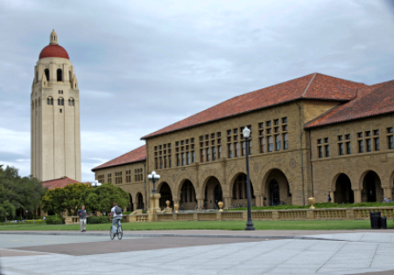
Innovation across the University
12
Entrepreneurial Leadership Driving Innovation
Innovative Models of
Teaching and Learning
Innovative Business Models
Innovative Research
and Industry Collaboration
Notes:
HEIs are being asked to be agents of transformation. So it’s worth standing back and considering what the building blocks of transformation might be. We see three, each being put in place, in different ways, around the world:
Innovation in the delivery of education
Collaborative research and
Partnerships for economic growth

Slide 10
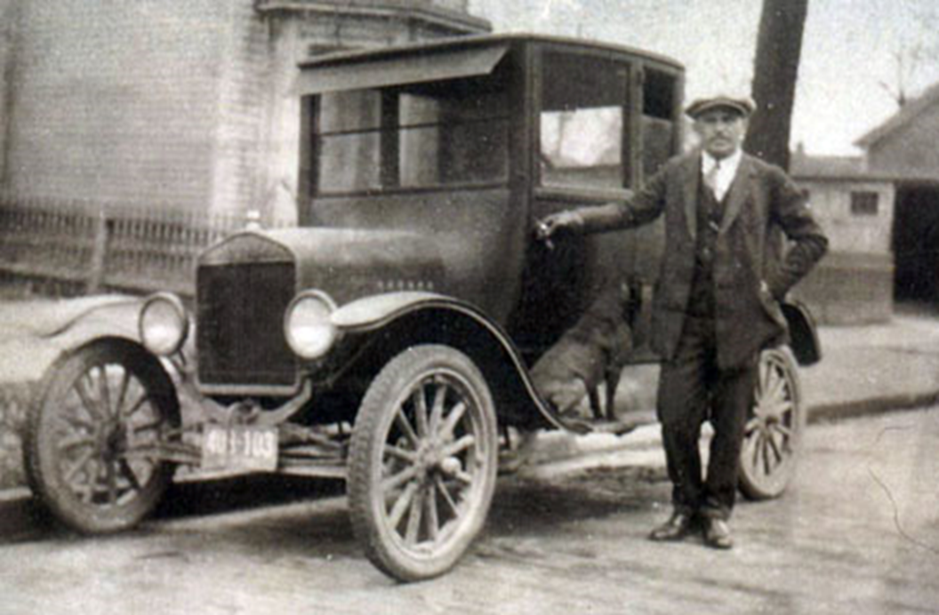
The Need for Change
Any Colour You Like as Long as It’s Black
Just Producing More of the Same?
Education | Training | Strategy

Slide 11
Avoiding the Trap
Physical: overinvesting in old systems or equipment blocks the pursuit of fresher, more relevant investments
Psychological: leaders fixate on past success, blind to disruptive innovations
Strategic: focusing purely on today’s market, failing to anticipate the future
Vijay Govindarajan: The Other Side of Innovation
Education | Training | Strategy

Slide 12
Adapting to Survive
Education | Training | Strategy

Slide 13
Business Models: The Challenge of the New
Education | Training | Strategy

Slide 14
Becoming Global – Accelerated by Technology
13
Innovation Across
the University
Collaborative
Teaching and Research
Outreach:
International and Regional
Notes:
HEIs are being asked to be agents of transformation. So it’s worth standing back and considering what the building blocks of transformation might be. We see three, each being put in place, in different ways, around the world:
Innovation in the delivery of education
Collaborative research and
Partnerships for economic growth

Slide 15
University of the 21st Century
Wired and Wireless
Online and
Blended Learning
Video Intensive
Collaboration Intensive
Paperless Library
Device Independent
Location Independent
Time Independent
Education | Training | Strategy

Slide 16
Paperless Libraries: Loyola and BiblioTech
“For the taxpayer, it’s far more economical to build and maintain an elibrary.”
“Traditional libraries require much larger load-tolerances in construction due to the weight of materials, so are more costly to build. Book collections also require environmental controls that are costly to maintain.”
Dr Robert Schwarzwalder, Stanford University
“Geography doesn’t matter if your library is in the cloud. The thing that excites me most is that our staff can dedicate their time to helping visitors. They aren’t tied up re-shelving, filing and categorising. It’s a more interactive library experience.”
Laura Coles, BiblioTech, Bexar, Texas

Slide 17
Bringing Experts Together Across Borders
16

Slide 18
Entrepreneurship and the World of Work
Minor in Entrepreneurship: All students will take at least a minor (33%) in Entrepreneurship. This will involve:
learning about entrepreneurship;
demonstrating the entrepreneurial mindset in action.
Small Business Incubator: The University will establish a small business incubator to provide:
expert guidance on starting a new enterprise;
seed funding for viable projects.
Internship: Students will be required to take a work placement or internship:
either for a full academic year or for a summer;
in Oman or internationally.
International Experience: Every student will spend time abroad. This international experience may be:
the period the students spend on their work placement or internship;
a period of study of at least a full semester attached to a partner institution.
Education | Training | Strategy

Slide 19
On Leadership: Servants or Shapers?
"All too often, on the long road up, young leaders become 'servants of what is rather than shapers of what might be'. In the long process of learning how the system works, they are rewarded for playing within the intricate structure of existing rules.
By the time they reach the top, they are very likely to be trained prisoners of the structure. This is not all bad; every vital system reaffirms itself. But no system can stay vital for long unless some of its leaders remain sufficiently independent to help it to change and grow.”
John W Gardner, former Health and Education secretary under the 1960s American President Lyndon Johnson
Education | Training | Strategy

Slide 20
Thank you
Best wishes to all Libya’s universities in achieving their key development goals.
For further information, please contact CorCordi at:
kdunseath@corcordi.com
+971-50-8698049
www.corcordi.com
Education | Training | Strategy

